Slide 1
Provider Management: Clinic User Training
Presented By:
Lucía Lapaz, Brittany Ersery & Jim Holsinger
Envision Technology Partners, Inc.
September 2019

Slide 2
Agenda
Overview
Notifications
Manage Assets
Storage Units
Recording Temperatures
Change Requests
Enrollments

Slide 3
Overview
Provider Management (PM) modules:
Clinic Tools (used by clinic staff)
Program Tools (used by IIS administrators)
Ability to manage refrigerator, freezer, and temperature monitoring assets per clinic
Ability to easily submit clinic information changes
Self-serve VFC and 317 enrollment

Slide 4
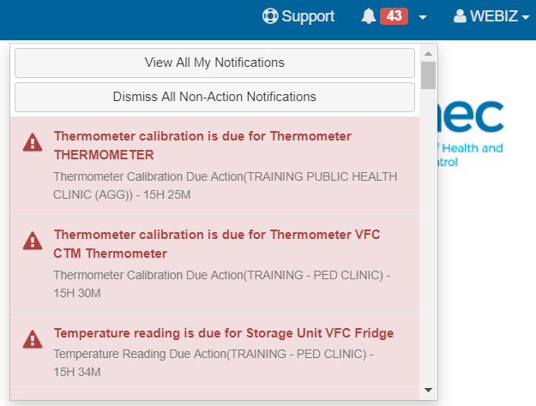
Notifications
Two types of notifications:
Red – Requires further action by the user
Yellow – Informational, no action required
Click the down-arrow next to the Bell icon to view pending notifications.

Slide 5
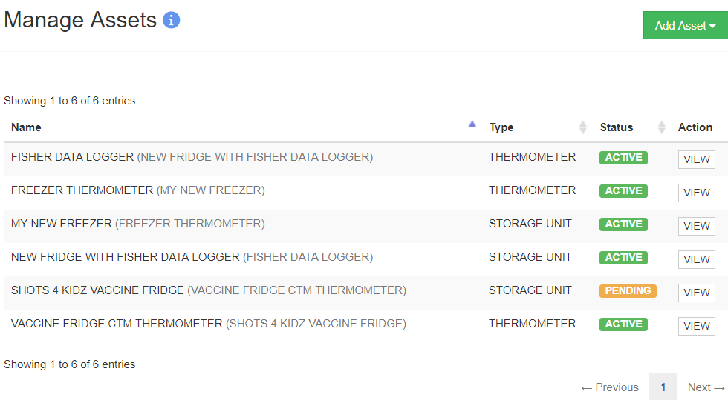
Manage Assets
1
2
Click to add a new asset (storage unit or thermometer)
Click to view a previously created asset.

Slide 6
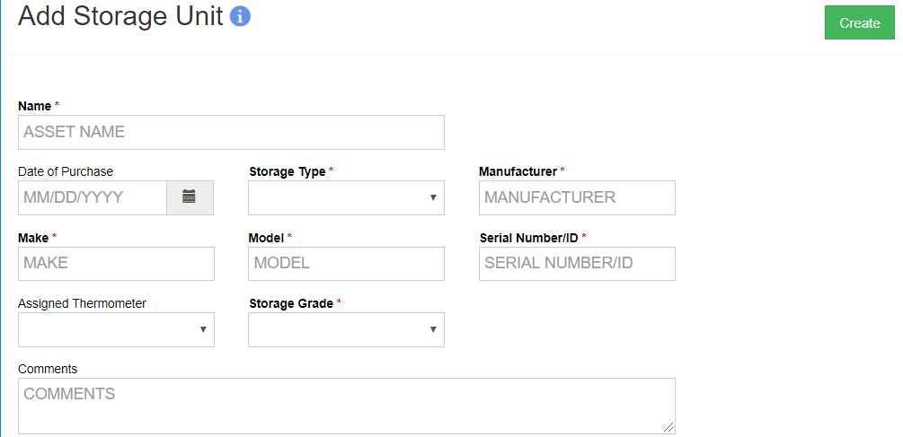
Adding a Storage Unit
4
1
2
Give the new asset a Name.
Select the Storage Type.
Assign a thermometer if a thermometer has been previously created and is un-assigned.
Click Create when all required fields are complete.
3

Slide 7
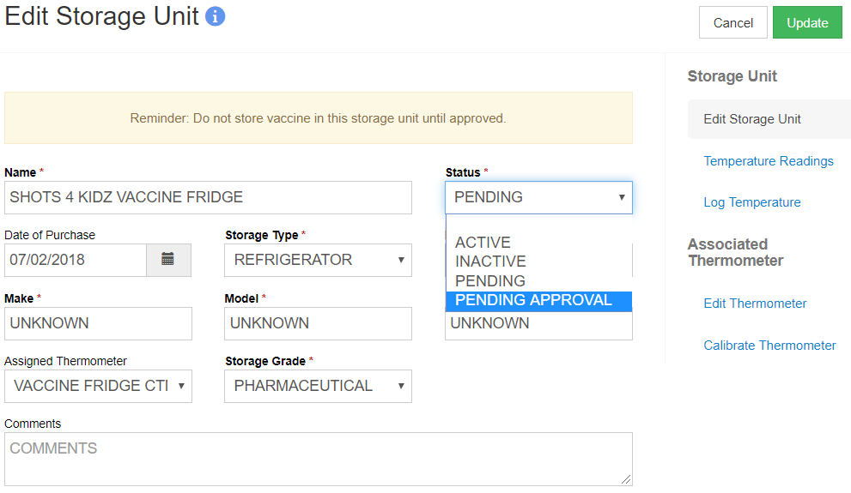
Adding a Storage Unit (cont.)
3
1
2
After clicking Create, a warning message will display.
Change the status to Pending Approval to send notification to the Program for approval.
Click Update to save changes.

Slide 8
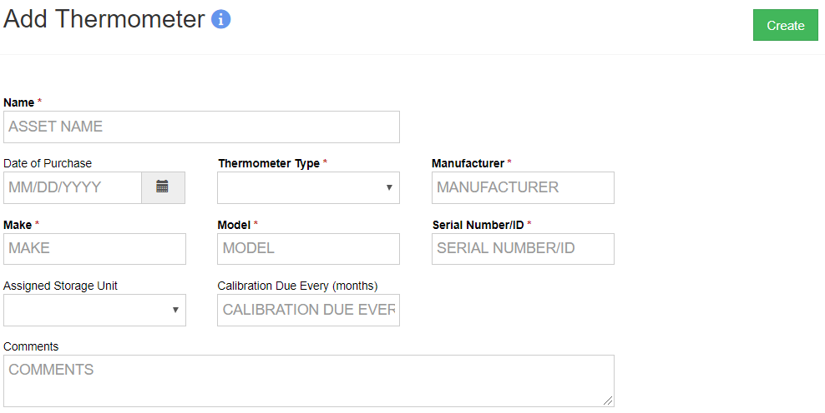
Adding a Thermometer
4
1
2
3
Give the new asset a Name.
Select the Thermometer Type.
Assign the thermometer to a storage unit.
Click Create when all required fields are complete.

Slide 9
Temperature Recordings
Once the Storage Unit is approved and the Thermometer assigned, readings can be recorded as:
Manual
Uploaded CTM file (CSV file format)
Excursions and /or Failures are flagged based on system settings

Slide 10
Storage Units Summary
3
1
2
Due date for next temperature reading.
Last reading summary.
Click to add a new temperature reading.

Slide 11
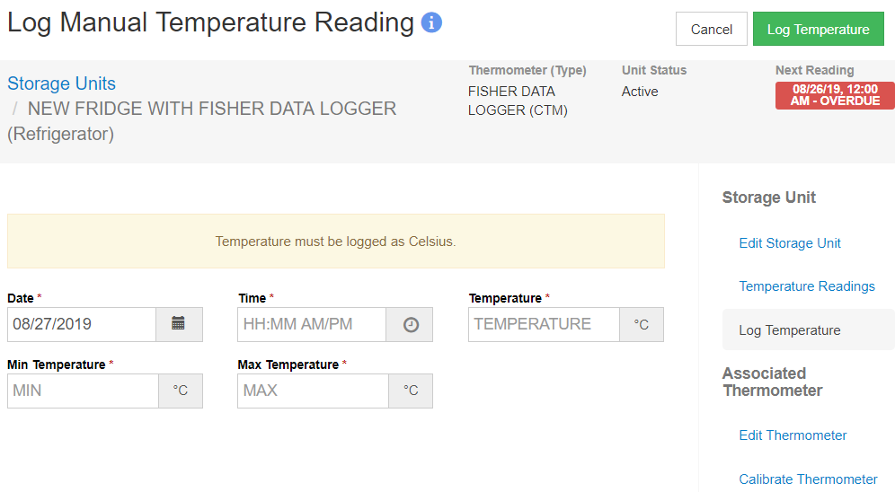
Recording a Manual Temperature
Enter the Date and Time of the recording.
Enter the current Temperature.
Enter the Min/Max Temperature.
Click Log Temperature.

Slide 12
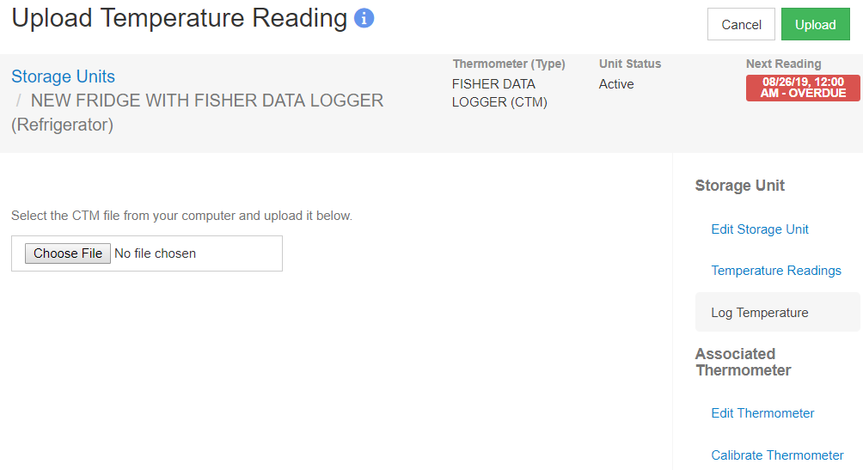
Recording a CTM Temperature
Click Choose File to import saved CSV file.
Click Upload.

Slide 13
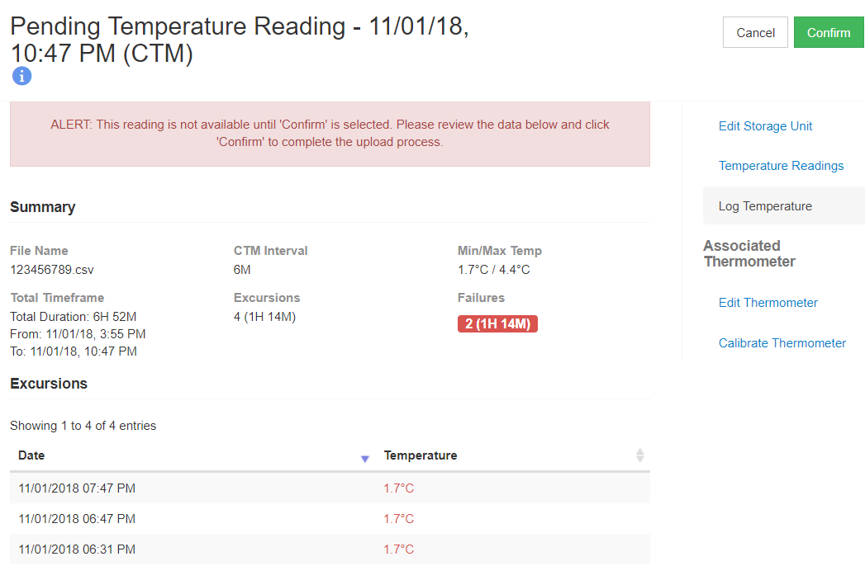
Temperature Recordings (cont.)
3
1
Summary of uploaded temperature file.
Summary of recorded Excursions.
Click to Confirm temperature file and save the recordings.
2

Slide 14
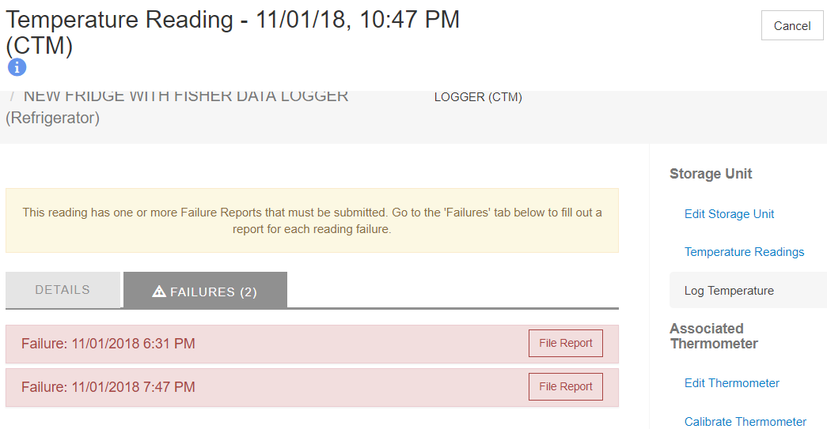
Reporting a Failure
1
Click the Failures tab.
Click File Report.

Slide 15
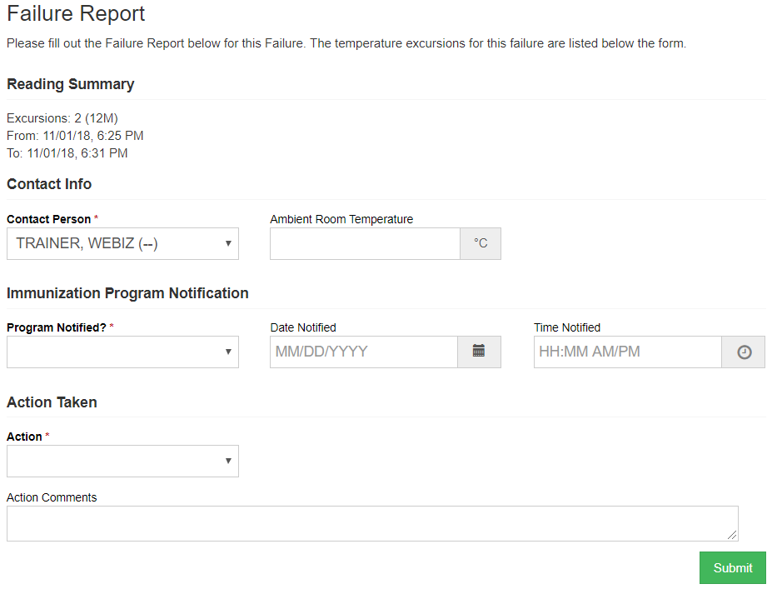
Failure Report

Slide 16
Change Requests
Clinic users can submit the following requests:
Address/Name change
Contact Information (Phone/Fax)
Delivery Hours
Staff
Address/Name changes and Staff changes require approval from the VFC Program.

Slide 17
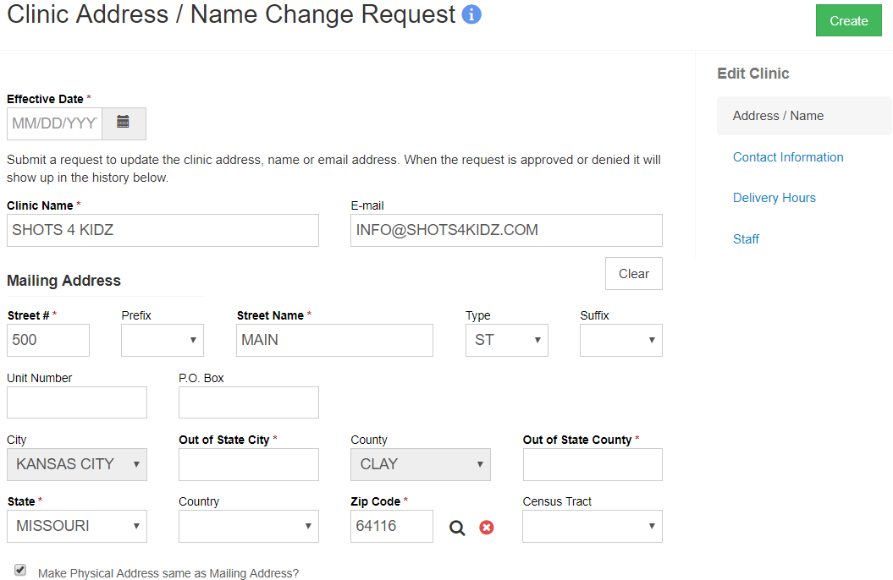
Address/Name Change Request

Slide 18
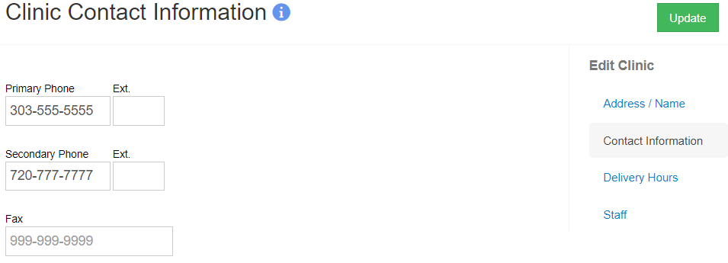
Contact Info Change Request

Slide 19
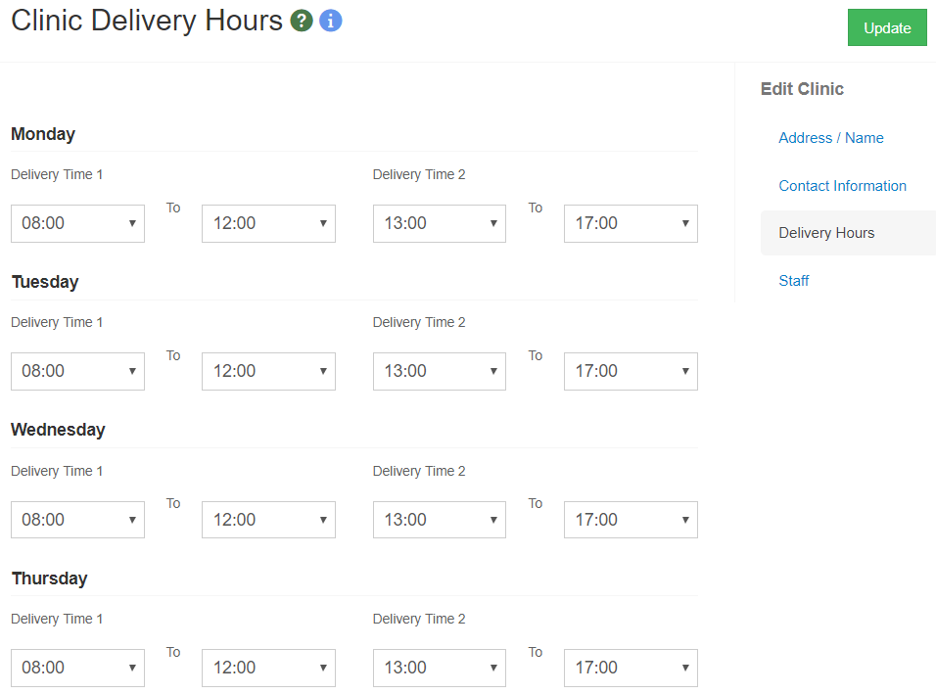
Delivery Hours Change Request

Slide 20
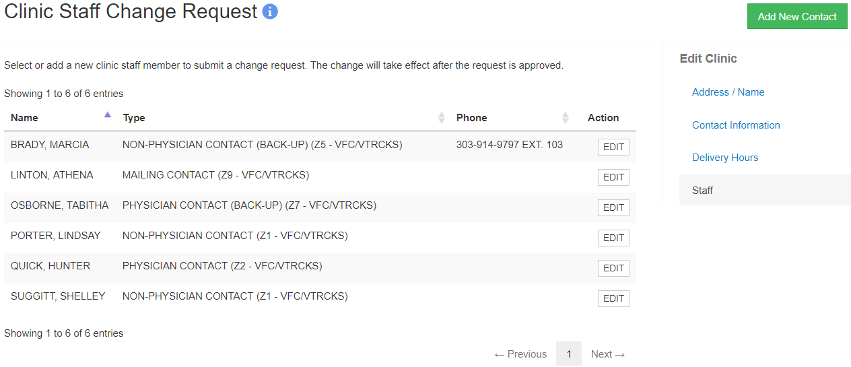
Staff Change Request
1
2
Click to Add New Contact.
Click Edit to modify an existing contact.

Slide 21
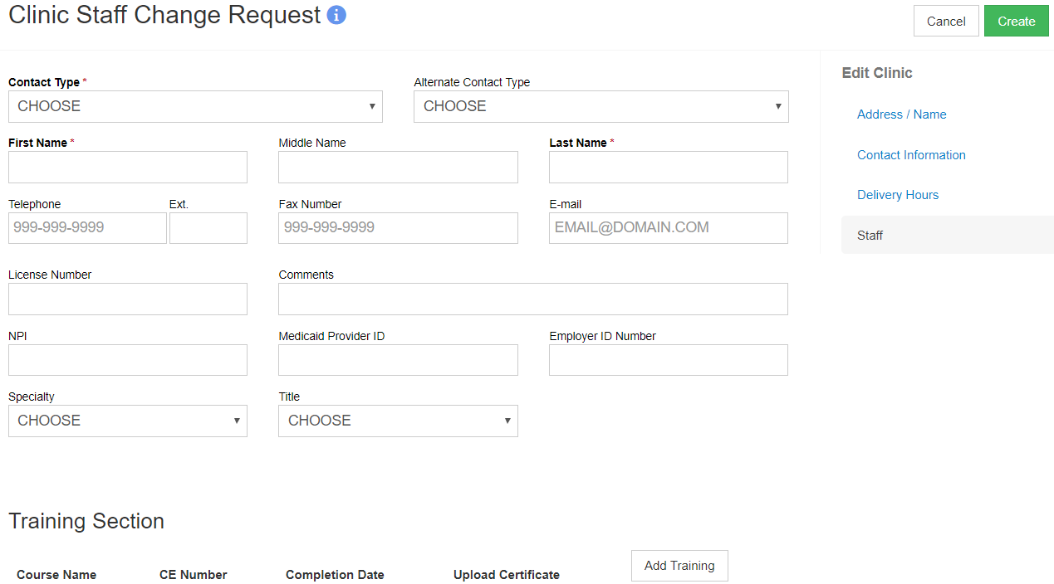
Staff Change Request (cont.)
4
1
2
Select the Contact Type.
Enter the staff member’s information.
Add Training for the staff member.
Click Create.
3

Slide 22
Enrollments

Slide 23
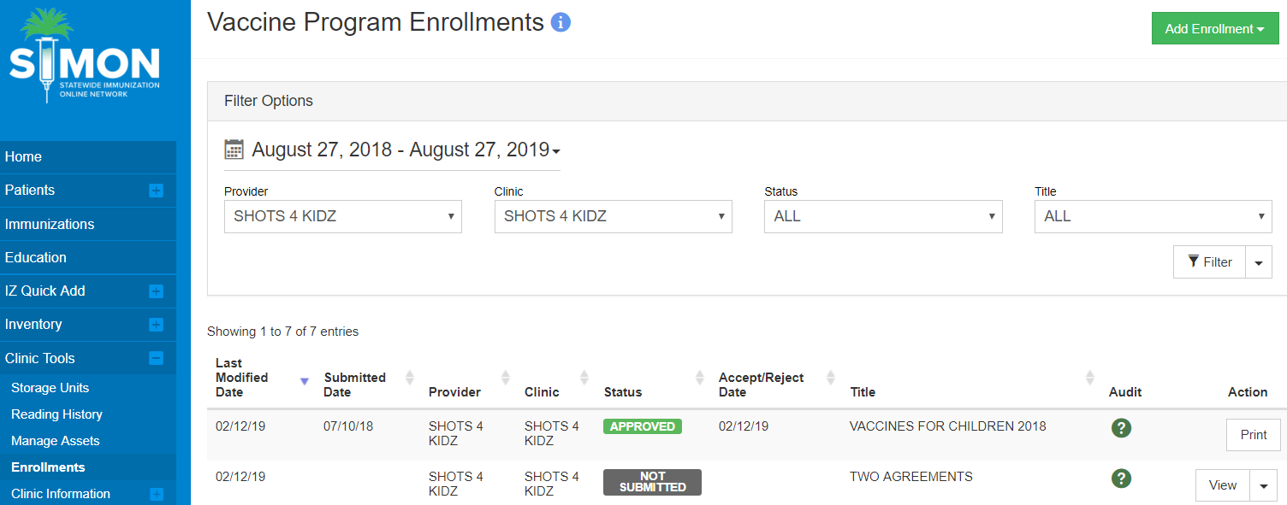
Submitting a New Enrollment
2
1
3
Navigate to Clinic Tools > Enrollments.
Click Add Enrollment to create a new enrollment.
Click View to modify an enrollment not yet submitted.

Slide 24
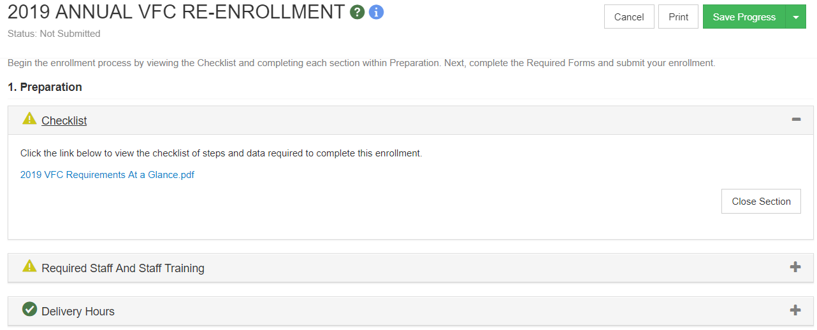
Submitting an Enrollment (cont.)
3
2
1
Click +/- to expand or collapse the section.
Click Save Progress to save and complete enrollment at a later date.
Click Print to print the enrollment.

Slide 25
Submitting an Enrollment (cont.)
Once each section is complete the yellow warning icon will change to a green checkmark.

Slide 26
Required Staff and Staff Training
1
2
User is notified of missing staff requirements.
Click the Manage Clinic Staff link to update staff information.

Slide 27
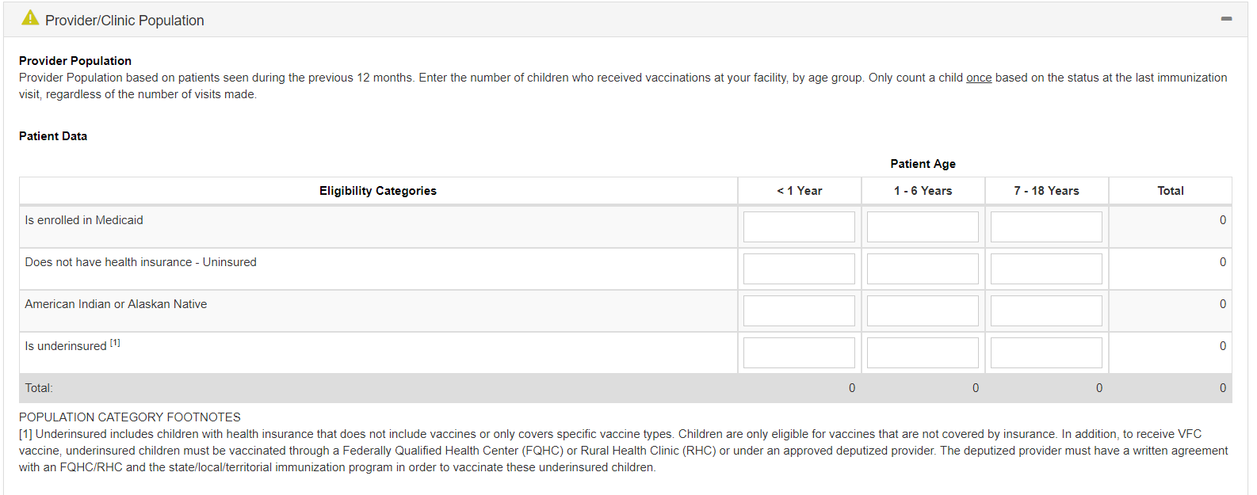
Provider/Clinic Population
Enter the number of patients for each age group and eligibility.
Only count each patient once.

Slide 28
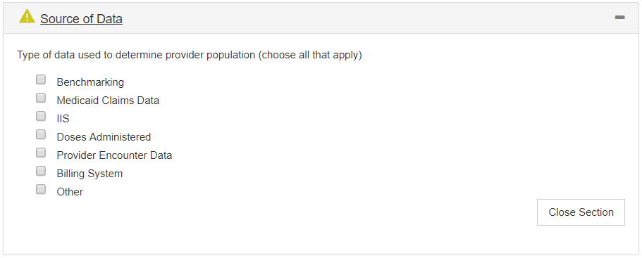
Source of Data
Select the data source for the Provider population.
Check all that apply.

Slide 29
Primary/Secondary Agreements
Click the Agreement button to view the agreement. Only the Signing Physician (Z3) can sign the agreement(s).

Slide 30
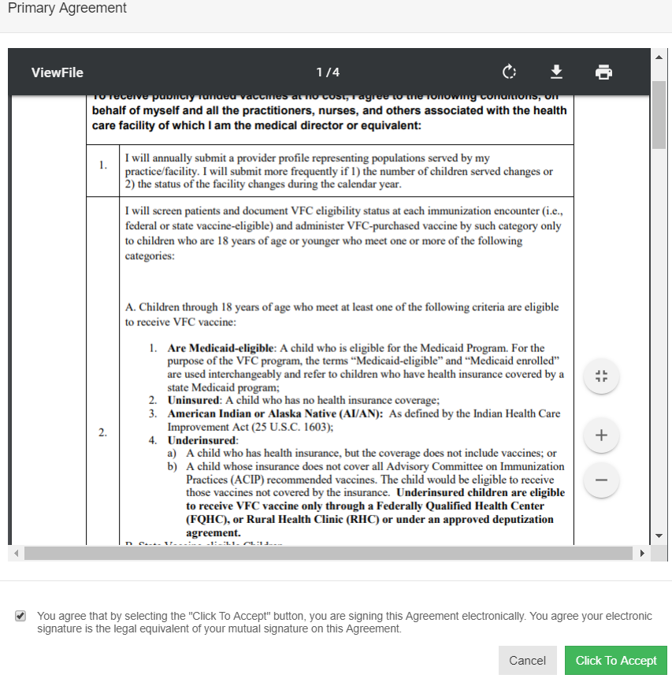
Primary/Secondary Agreements (cont.)
Check the check-box to agree, then select the Click To Accept button to electronically sign the agreement.

Slide 31
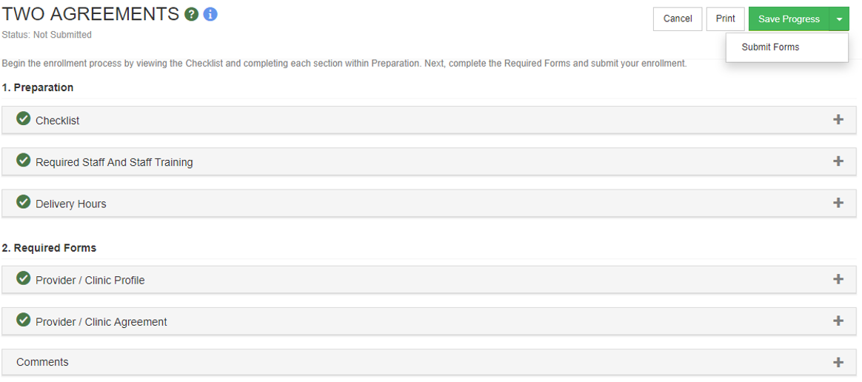
Complete/Submit Enrollment
1
2
Once all sections are complete, click Save Progress.
Click Submit Forms to submit the enrollment for approval.

Slide 32
Enrollment Notifications
Signing Physician contacts will receive notifications regarding:
Current enrollment is set to expire soon.
A submitted enrollment has been approved or rejected.

